Slide 1

Apache Spark Architecture

Slide 2
What is Apache Spark?
Definition: Apache Spark is an open-source, distributed computing system designed for fast and large-scale data processing.
Features:
In-memory computing
Fault tolerance
Scalability
Unified analytics engine

Slide 3
Spark Architecture Overview
Main Components:
Driver Program
Cluster Manager
Executors
Tasks

Slide 4
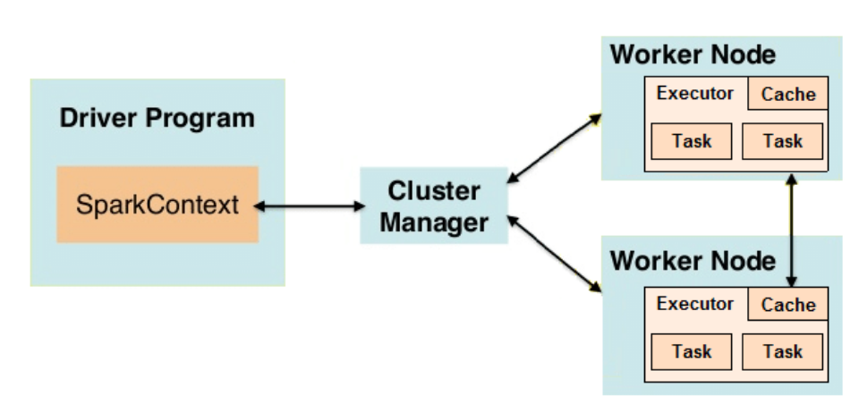

Slide 5
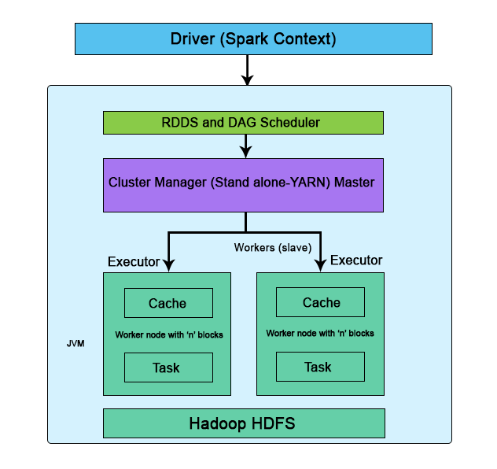

Slide 6
Driver Program
Role: Coordinates the execution of tasks and manages the Spark application.
Responsibilities:
Translates user code into jobs and tasks
Schedules tasks across executors
Monitors job progress and handles failures
Example: The driver program for a data processing application might be responsible for managing a data transformation job, such as filtering and aggregating large datasets.

Slide 7
Cluster Manager
Role: Manages resources and schedules applications.
Types:
Standalone
Apache Mesos
Hadoop YARN
Responsibilities:
Allocates resources to Spark applications
Manages the lifecycle of executors
Example: In a Hadoop YARN cluster, the cluster manager will allocate resources from the Hadoop resource manager to run Spark jobs.

Slide 8
Executors
Role: Execute tasks and store data for a Spark application.
Responsibilities:
Run tasks and report the results to the driver
Store data in memory or disk
Provide fault tolerance by re-computing lost data
Example: Executors on worker nodes might perform operations such as sorting and joining data partitions.

Slide 9
Tasks
Role: The smallest unit of work in Spark.
Characteristics:
Operate on data partitions
Run in parallel across executors
Example: A task might perform a map operation on a partition of a dataset, transforming each record according to a user-defined function.

Slide 10
Spark Execution Flow
User submits a Spark application to the Driver.
Driver creates a SparkContext and connects to the Cluster Manager.
Cluster Manager allocates resources and launches Executors.
Driver divides the job into stages and tasks, then schedules them on Executors.
Executors execute the tasks and report the results back to the Driver.
Driver aggregates results and returns the final output to the user.

Slide 11
Example Workflow
Scenario: Processing a large dataset for word count.
Steps:
Driver Program: Initializes SparkContext and submits the job.
Cluster Manager: Allocates resources and launches Executors.
Executors: Execute map tasks to split data and count words.
Aggregation: Reduce tasks aggregate word counts and output results.

Slide 12


